Slide 1
Customer Segmentation for
Variable Annuity Products
Interim Delivery
Mobing Zhuang
Sha Li
Yawen Li
Interdisciplinary Data Science Masters Program, University of Washington

Slide 2
Project Motivation
Variable annuities have become a part of the retirement and investment plans of many Americans.
Customers purchase a variable annuity contract by making either a single purchase payment or a series of purchase payments. Under the contract, the insurer agrees to make periodic payments to customer, beginning either immediately or at some future date.
In the U.S., there are $2 trillion in assets in variable annuity (VA) market under management.
The big challenge for insurers: relatively little ability to distinguish between policyholders that will behave in different ways.
This project sponsor Milliman has been a leader in actuarial consulting since 1947.
Notes:
A variable annuity is a contract between a customer and an insurance company. With a variable annuity, the insurance company agrees to make periodic payments to the customer in the future. Variable annuities have become a part of the retirement and investment plans of many Americans.
Policyholder behaviors have an enormous impact on how much it will cost insurers to provide a product. The large uncertainty in the variable annuities space around policyholder’s behavior poses risk towards insurance companies. The big challenge in front of most insurers is that most of them have relatively little ability to distinguish between policyholders that will behave in different ways.
This project is requested by sponsor Milliman, which has been a leader in actuarial consulting since 1947.
The goal is to use predictive analytics to understand policyholders’ behaviors and to distinguish policyholders’ profitability for their client insurers.

Slide 3
Proposed work
Perform customer segmentation analysis, thus provide accurate estimation of policyholder’s behavior:
Enrich the data set: missing values imputation and feature selection
Improve the current clustering technique, K-means Convergence and initial partition: reasonable initial partition, fast convergence, and a global search of optimum. The number of K: implement algorithms to find optimum number of clusters. Robustness: implement algorithms to be resilient to outliers and noise. Extension of definition of means: replace means with other metrics in the algorithm
Explore and compare K-means with other nonlinear clustering method We will use perform nonlinear transformation on the data matrix and compare the clustering.
Notes:
Our proposed work includes collecting and generating significant customer data to identify customers’ behaviors by enhancing the original data from insurance companies with data from other sources, developing robust predictive analytics models based on enhanced data for customer segmentation, and differentiating between their profitability.
Also, we plan to explore and compare k-means with other nonlinear clustering method, such hierarchical clustering, fuzzy k-means and GMM

Slide 4
Data Description
Census Data
Population density
Demographic
Income
Housing
Workforce
Credit Data
Length of credit history
Recent credit seeking
Utilization
Payment history
Public records
Scores
Mortgage Data
Loans
Property
Neighborhood
Challenges
Multiple sources
Large data size (12.8 GB .rds) and large amounts of features (1064)
Mixed data types: numerical and categorical. Challenging for clustering algorithms
Consumer Data
Lifestyle
Financial
Property
Marketing scores
Census
Notes:
Our data are made up by four sources. Census tract and block group level data, Consumer data, which includes various marketing scores and household lifestyle clusters. Credit data is compiled from lenders such as credit card issuers, auto finance companies, and collection agencies and courts. Mortgage data, which is compiled from county property tax and deed records and mortgage lenders.
We face three major challenges of our current data.
Time consuming for feature selection due to large amount of variables
K-means and its improved algorithms can only handle numerical data. We’ll talk about how we plan to deal with mixed numerical and categorical data later

Slide 5



Model Development -1
K-harmonic Means
Objective Function:
K-means:
K-harmonic:
Harmonic Average
Notes:
KHM is similar to KM in that they are both center-based iterative algorithm.
The k-means algorithm minimizes the total mean squared distance for each point and the closest center.
Each point is implicitly assigned to exactly one center.
HA is the harmonic average for each data point. Unlike k-means, this algorithm uses information from all of the centers to calculate the harmonic average for each point, no center completely owns a point
The harmonic average assigns a large weight to a data point that is not close to any centers and a small weight to the data point that is close to one or more centers. Thus, k harmonic means is much less sensitive to initial conditions.

Slide 6
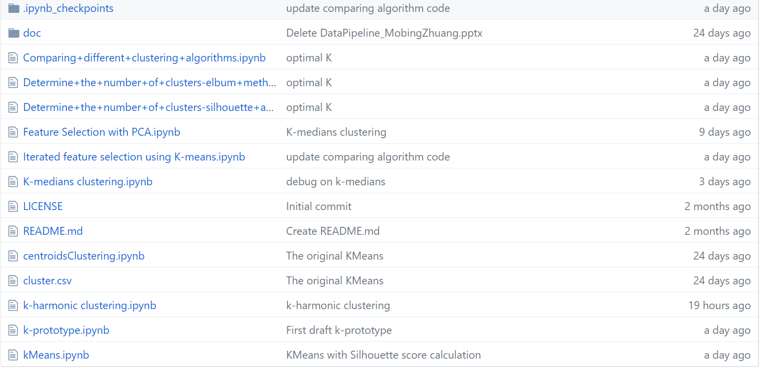
Model Development -2
K-means extension: replace means with medians or modes.
K-medians : calculates the median for each cluster as opposed to calculating the mean of the cluster (as done in K-means). The distance measure used in the K-medians is the L1-norm as opposed to the square of the L2-norm used in the K-means algorithm. Better tolerate outliers.
K-modes: The loss function in K-modes clustering works as a metric and uses the number of mismatches to estimate the similarity between the data points (assign data points to the cluster with the nearest mode). Can handle categorical data.
K-prototype:
clustering algorithm for mixed numerical/categorical data.
tot_costs = num_costs + gamma * cat_costs.
Gamma determines the weighting of categorical values.
Notes:
Sha

Slide 7
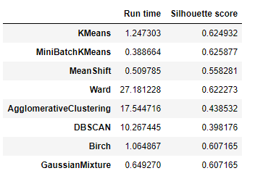
Compare clustering algorithms
Algorithm | Advantage | Disadvantage | Scalability
K-Means | Running Time; Better for high dimensional data; Easy to interpret and Implement. | Assumes the clusters as spherical, so does not work efficiently with complex geometrical shaped data (Mostly Non-Linear); Hard Assignment might lead to mis grouping. | Very large n, medium K
Minibatch K-Means | Reduce the convergence time of k-means | Slightly worse performance compared to standard | Not scalable with n
MeanShift | Simplicity, only one parameter—the kernel bandwidth value is needed, does not require number of clusters to be specified | N-squared algorithm, slow. However, it’s parallelizable. | Not scalable with n
Ward hierarchical clustering | When spherical multivariate normal distributions are used, Ward’s method is excellent | Ward’s method only performs well if an equal number of objects is drawn from each population and that it has difficulties with clusters of unequal diameters. | Large n and K
Agglomerative clustering | Any valid measure of distance can be used | Time complexity O(n3) and requires O(n2) memory | Large n and K
DBSCAN | Clusters can be any shape, and no need to specify number of clusters. As opposed to k-means which assumes that clusters are convex shaped. | Is not entirely deterministic and cannot cluster data sets well with large differences in densities | Very large n and medium K
Gaussian mixtures | Does not assume clusters to be of any geometry. Works well with non-linear geometric distributions as well.; Does not bias the cluster sizes to have specific structures as does by K-Means (Circular). | Uses all the components it has access to, so initialization of clusters will be difficult when dimensionality of data is high; Difficult to interpret. | Not scalable
*run time on a small subsample (1.25% original size)
K-means, Ward, Birch
Notes:
Sha

Slide 8
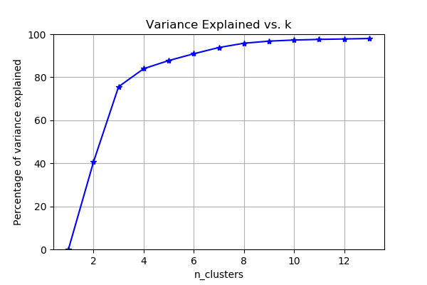
Determination of optimal K -1
Elbum method
Optimal K: 7, 8, 9
Notes:
Sha

Slide 9
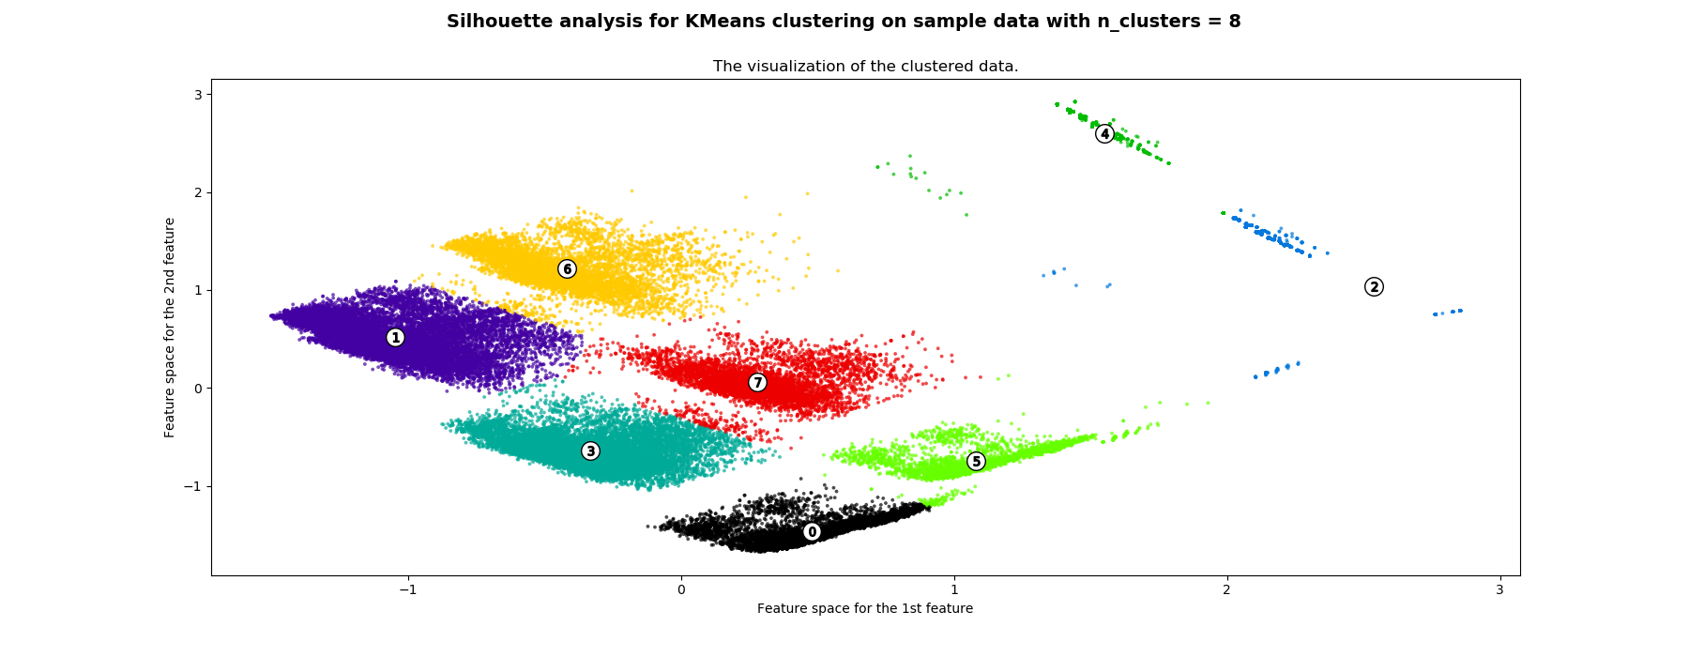
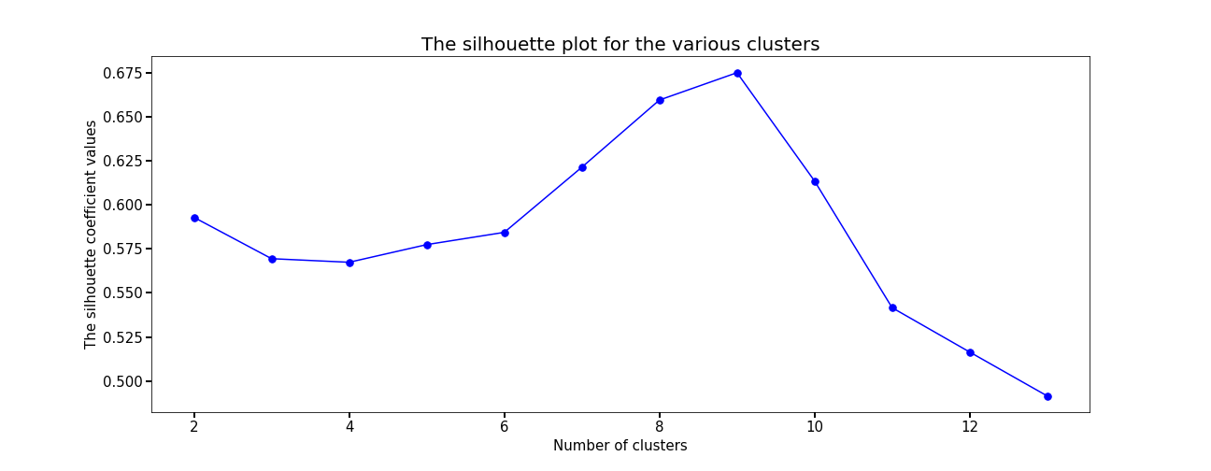
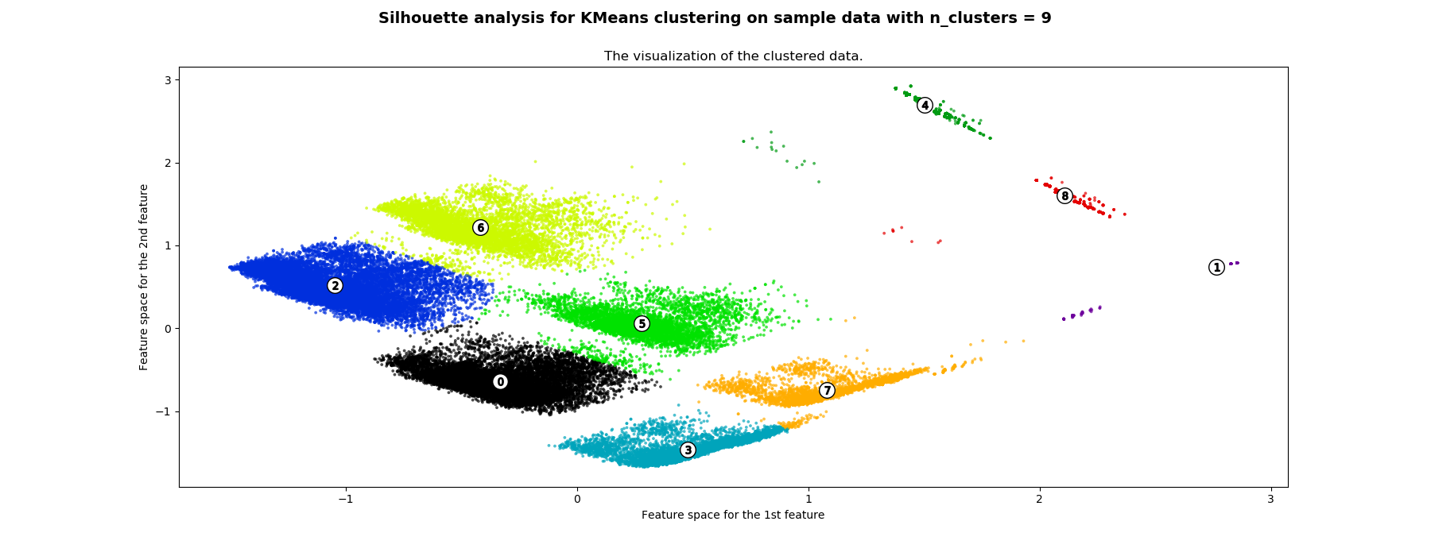
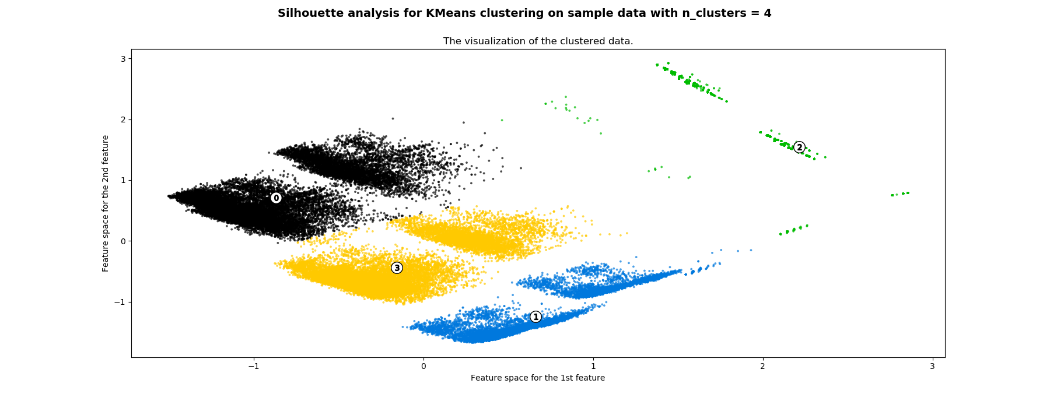
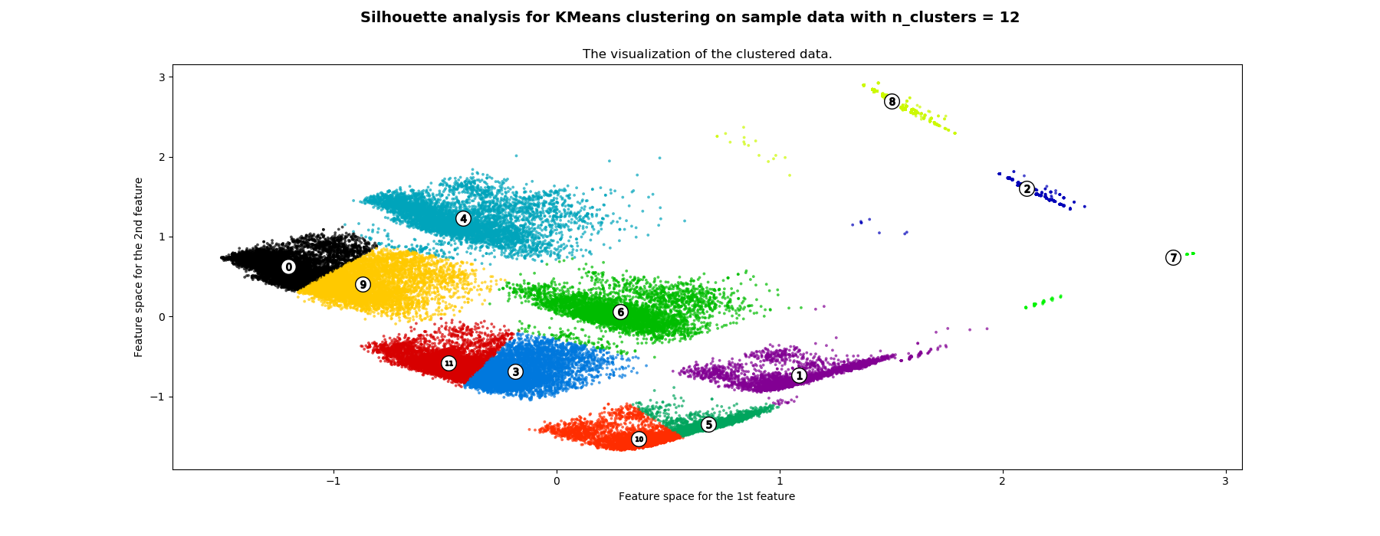
Determination of optimal K -2
Average silhouette method
Optimal K: 8, 9
Notes:
Sha

Slide 10
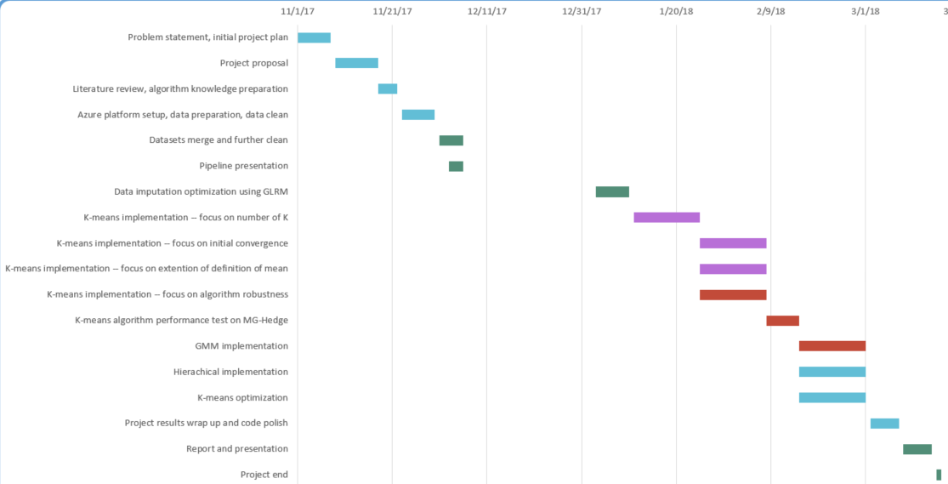
Schedule Review
On schedule: Complete Azure platform setup, literature review and algorithm knowledge preparation, data preparation.
Change: Missing value has been imputed with means in current work.
To do next: Value imputation using generalized low rank model (GLRM).
On schedule: K-means from scratch development, determination of cluster numbers. Extended K-means algorithms (K-medians, K-modes, K-harmonics) development.
Change: Feature selection using wrapper and filter models.
To do next: K-prototype algorithm development.
Feature selection optimization.
Clustering algorithms optimization on full size data.
Ahead of schedule: Other clustering algorithms performance comparisons with K-means
To do next: Model validation on MG-Hedge
Notes:
Sha
Sha

Slide 11
Challenge
Algorithm development from scratch: learning curve
Self-motivation; read books and literatures; discussions with group members
Balancing cost and work efficiency
Develop algorithms on subsamples first; group members work in parallel; communicate with the sponsor and justify our needs
Standard E4s v3 (4 vcpus, 32 GB memory) ~ $0.30/hour
Standard E16s v3 (16 vcpus, 128 GB memory) ~ $1.20/hour
Algorithm scalability and time complexity
Algorithm optimization; set up parallel computation jobs
Notes:
Sha

